Slide 1
Voice Biometrics - SBI
Powered By - Microsoft Corporation Pvt Ltd.

Slide 2

Problem Being Solved
TO PROVIDE SECURITY FOR UNKNOWN HUMANS WHO DONT KNOW TO ACCESS ONLINE
WORKING .AND THEY GET FROUDY PERSONS AND LOST HERE MONEY.
THEN THESE TYPE PERSON IGNORED DIGITAL CURRENCY.
SO WE SHOWOFF HERE A VOICE SECURITY WHICH IS VERY HELPFUL TO
UNKNOWN AND UNEDUCATED PERSON TO GET RID IN FROUD TO DIGITAL WAY.

Slide 3
Approach taken to create the modeL
A PERSON WHO HAVE LESS KNOWLEDGE IN SECURITY LEVEL OR LESS ADDECTIVE WHO DONT ACCESS A WRITTEN SECURITY..
SO HERE WE PRESENTING A VOICE DIGITAL SEURITY..WHO HELPS TO SECURE US AND
SAVE OUR TIME..

Slide 4
Prerequisites
TO DETERMINE PITCH OF VOICE.
TO RECOGNISE YOUR VOICE.
TO CHECK YOUR GLITCH OF VOICE
TO READ FREQUENCY.

Slide 5
Any Supporting Functional Documents
TO READ PITCHING VOICE
TO PRESCRIBE YOUR VOICE
TO RECOGNISE AND CHECK YOUR VOICE MANY TIMES.
TO READ PITCHING VOICE

Slide 6
BECAUSE WE REPRESENT ALL THE TASK IN
GITHUB REPOSISERITY.
WHICH IS VERY HELPFUL FOR TODAYS VOICE BIOMETRY.
reason why your solution should be considered

Slide 7
Source code (Github Repository Link)
https://rajeevkumar9598.github.io/SBI_HACKATHON/

Slide 8
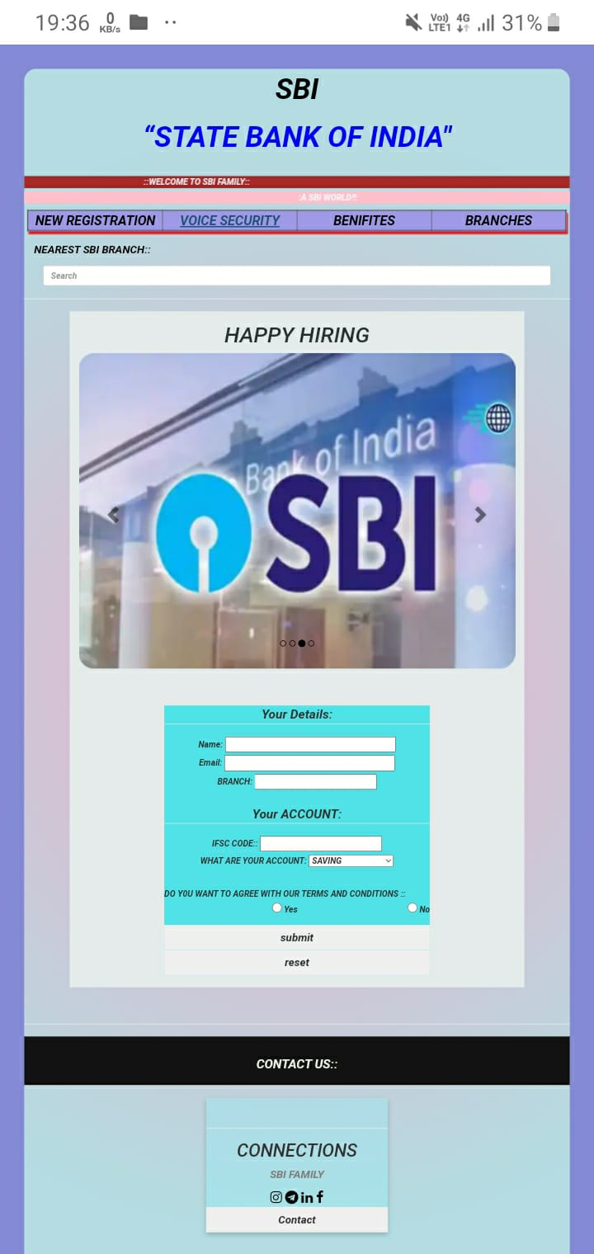
Demonstration Video showing the
functionalities/working of the solution.

Slide 9

Submitted By : RAJEEV KUMAR
Email :rajeevkumar95980@gmail.com
Mobile No: 9598909910

